Slide 1
Dynamic Workflows using the ADIOS I/O Middleware Library
Kshitij Mehta
ORNL

Slide 2
Background
Scientific Data Group at ORNL
Data Management
I/O
Compression
Staging
Data Movement
Metadata management
Data Analysis
Visualization

Slide 3
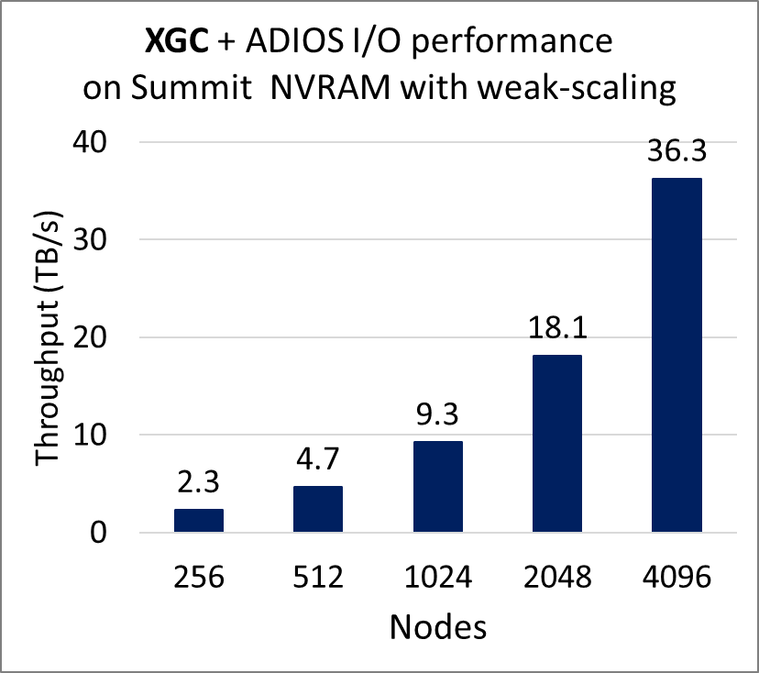
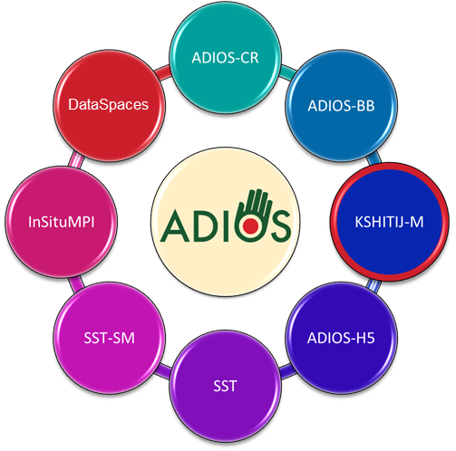

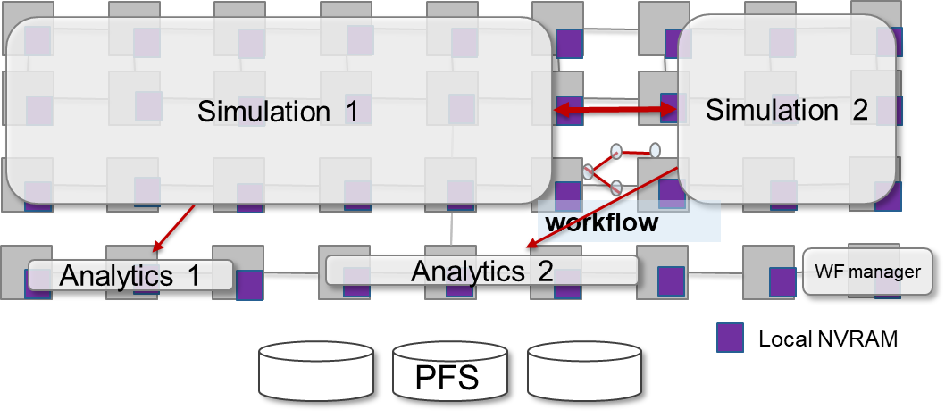
ADIOS: High-Performance Publisher/Subscriber I/O framework
Vision
Create a high performance I/O abstraction to allow for on-line/off-line memory/file data subscription service Create a sustainable solution to work with multi-tier storage and memory systems
Research Details
Declarative, publish/subscribe API is separated from the I/O strategy and use of multi-tier storage
Multiple implementations (engines) provide functionality and performance in different use cases
Rigorous testing ensures portability
Data reduction techniques are incorporated to decrease storage cost
36 TB/s
XGC writing particles on Summit’s local NVRAM: 18.3 TB in 0.5 seconds on 4K nodes
https://github.com/ornladios/ADIOS2

Slide 4
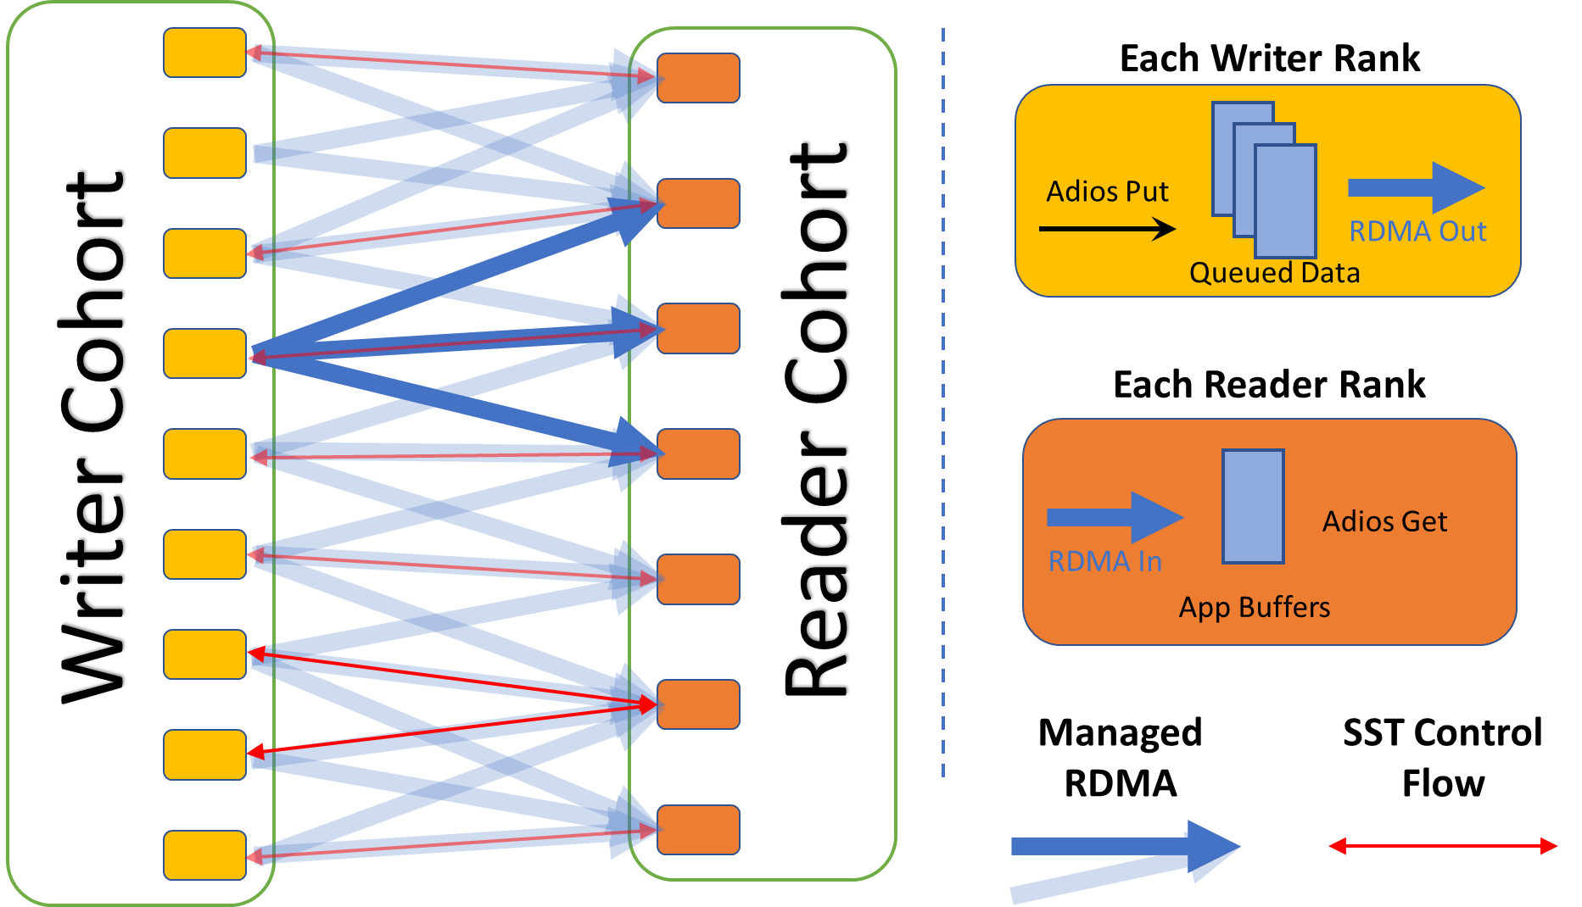
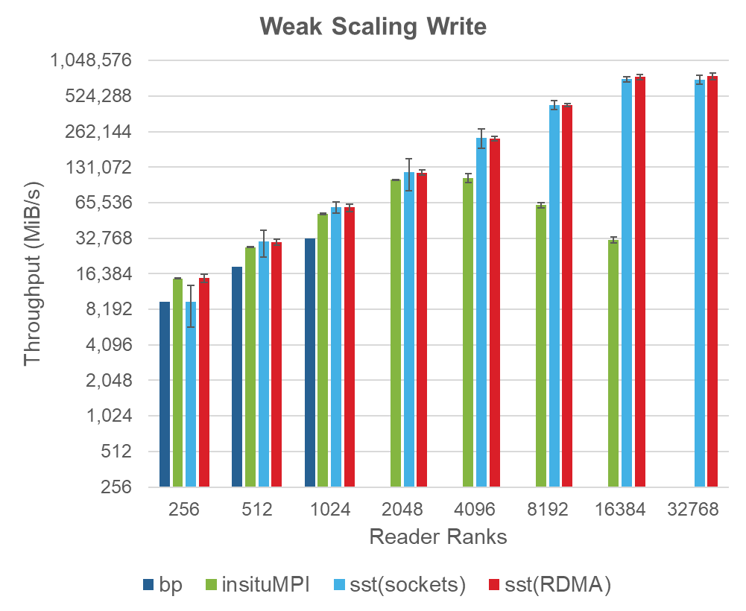
Sustainable Staging Transport (SST)
Provide a direct and high performance connection between an ADIOS writer and one or more readers
Communication between separate applications
Multiple transport mechanisms using libfabric
Efficiently handle data transfer and necessary refactoring
Avoid interfering with original computation as much as possible
Support dynamic behavior (readers come and go)
Be robust to client failure and resource availability changes
Writer Application
Reader Application

Slide 5
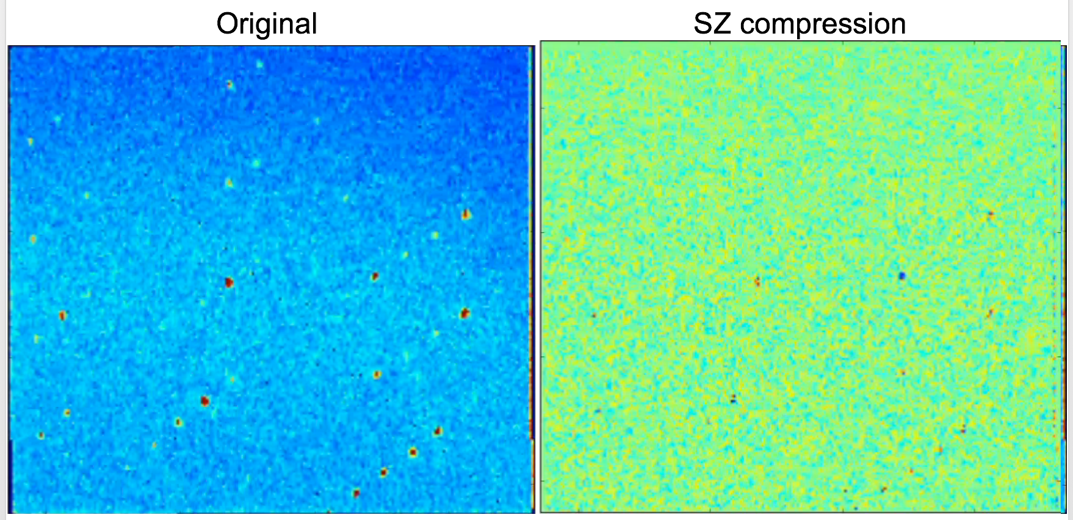
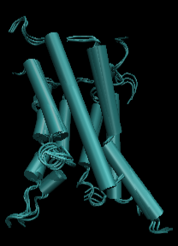
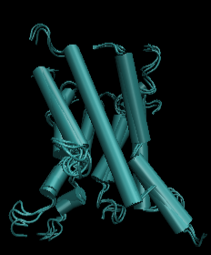
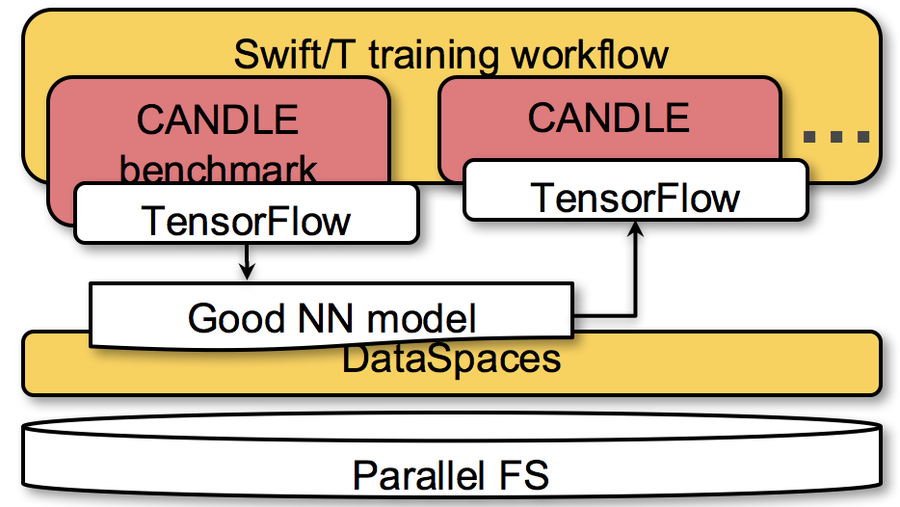
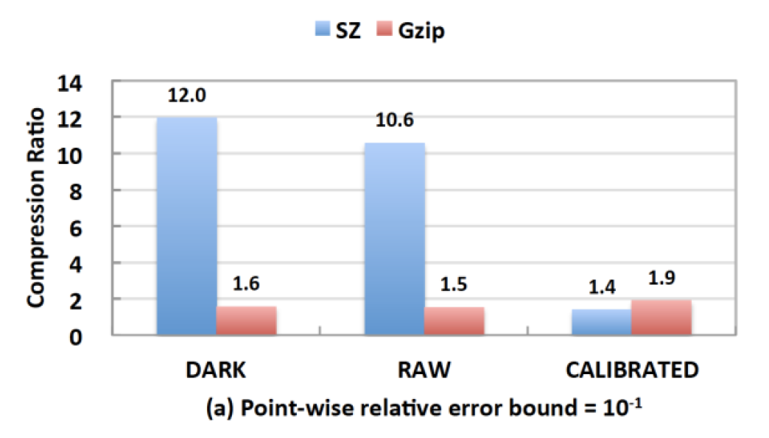
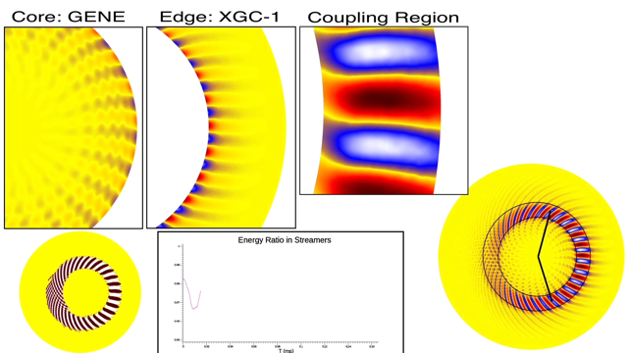
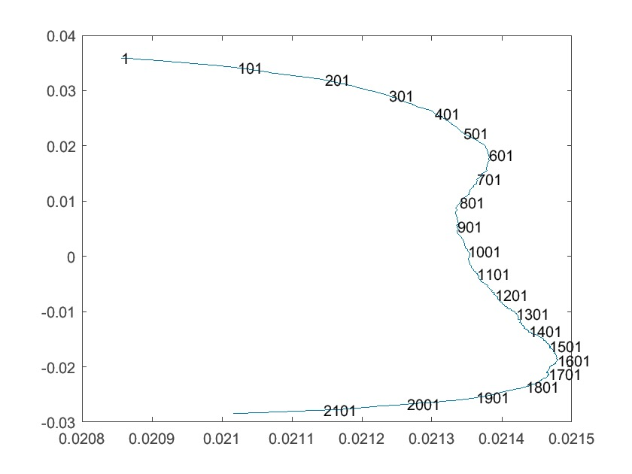
Code Coupling
as a Motif
Can couple tasks via file system?
Yes: Not our concern …
End-to-end Application workflow
No: Too much data to output, store, or analyze offline. Must couple tasks online.
Which tasks?
Application + Reduction
Many Applications
Application + Analysis
Application + Application
Online reduction
Online analysis
Online coupling
Online aggregation
XGC
Interpolator
GENE
1M atoms,
1B steps →
32 PB trajectories
Hyperparam. optimization:
10³–10⁶ training runs, each fitting many parameters
ExaFEL:
X-ray laser imaging
NWChemEx: Molecular dynamics
WDMApp: Fusion whole device model
CANDLE:
Cancer deep learning
Notes:
Code coupling: Lots of applications has been done historically via file I/O.

Slide 6
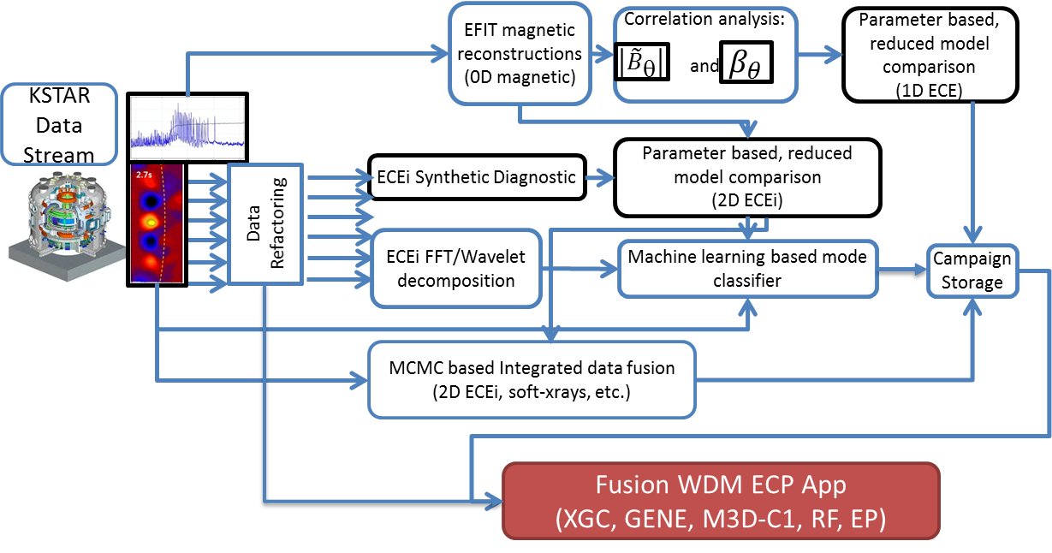
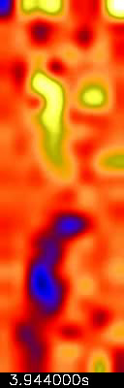
Near Real Time Analysis of Experimental Data
Electron cyclotron emission imaging (ECEI)
Markov chain Monte Carlo (MCMC)
New I/O Pattern: Streaming, reducing data from experiments to HPC with ML

Slide 7
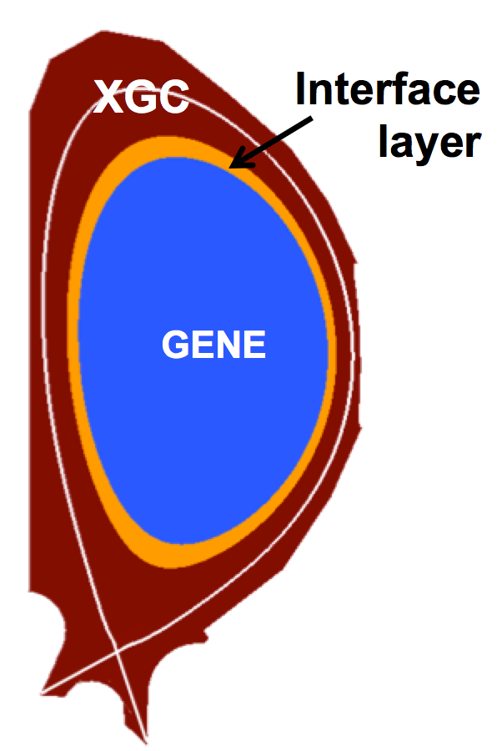
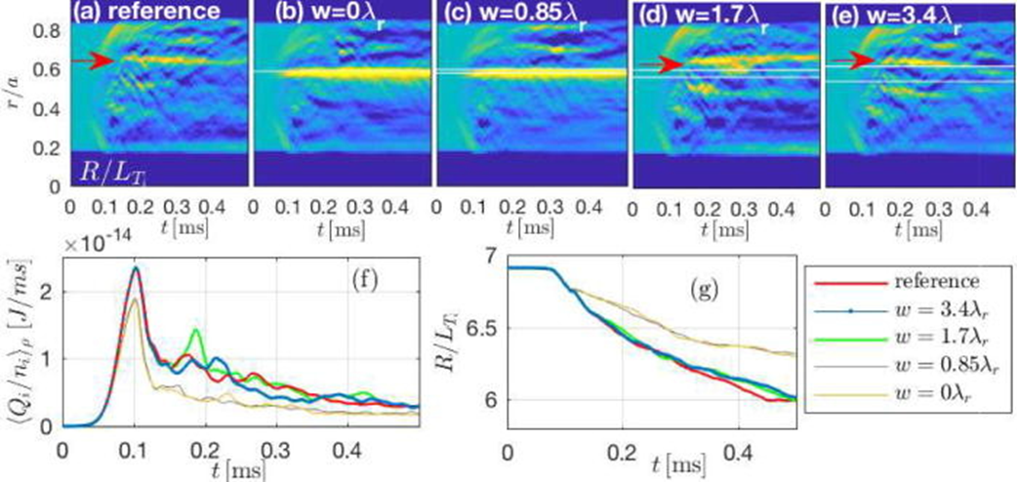
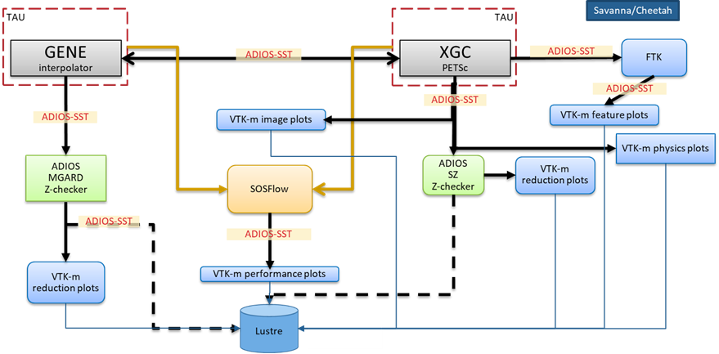
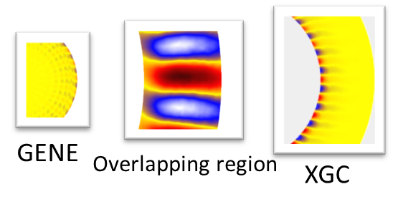
2.2.2.05 ADSE12-WDMApp: High-Fidelity Whole Device Modeling of Magnetically Confined Fusion Plasmas
PIs: Amitava Bhattacharjee, C. S. Chang PPPL
Different physics solved in different physical regions of detector (spatial coupling)
Core simulation: GENE Edge simulation: XGC Separate teams, separate codes
Recently demonstrated first-ever successful kinetic coupling of this kind
Data Generated by one coupled simulation is predicted to be > 10 PB/day on Summit
Core-edge
coupling
J. Dominski; S. Ku; C.-S. Chang; J. Choi; E. Suchyta; S. Parker; S. Klasky; A. Bhattacharjee; Physics of Plasmas 2018, 25, DOI: 10.1063/1.5044707
New I/O Pattern: emerging from running complex in situ workflows

Slide 8
Coupling Exascale Multiphysics Applications: Methods and Lessons Learned
IEEE eScience 2018 conference
Matthew Wolf
Jong Youl Choi
Choong-Seock Chang
Julien Dominski
Scott Klasky
Gabriele Merlo
Eric Suchyta
Mark Ainsworth
Bryce Allen
Franck Cappello
Michael Churchill
Philip Davis
Sheng Di
Greg Eisenhauer
Stephane Ethier
Ian Foster
Berk Geveci
Hanqi Guo
Kevin Huck
Frank Jenko
Mark Kim
James Kress
Seung-Hoe Ku
Qing Liu
Jeremy Logan
Allen Malony
Kshitij Mehta
Kenneth Moreland
Todd Munson
Manish Parashar
Tom Peterka
Norbert Podhorszki
Dave Pugmire
Ozan Tugluk
Ruonan Wang
Ben Whitney
Chad Wood
Argonne National Lab.
Brown University
Georgia Institute of Technology
Kitware
New Jersey Institute of
Technology
Oak Ridge National Lab.
Princeton Plasma Physics Lab.
Rutgers University
Sandia National Lab.
Univ. of Chicago
Univ. of Oregon
Univ. of Texas – Austin
Univ. of Tennessee – Knoxville

Slide 9
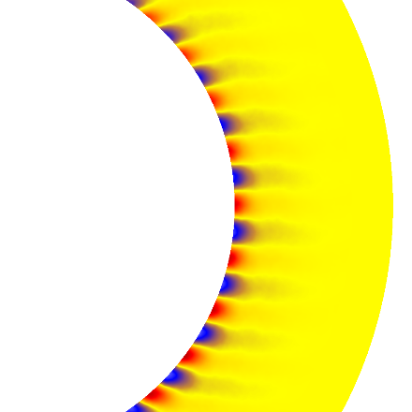
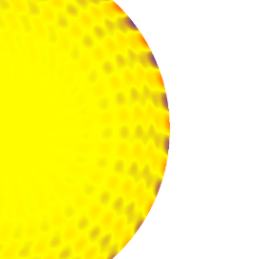
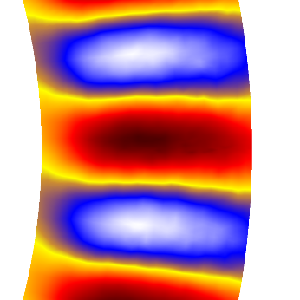
Code Coupling
Goal is to provide the capability to couple multiple codes through files, memory on the same node, memory on different nodes
Codes are orchestrated from a “controller” service, which monitors, all of the different codes (executables)
XGC
Initialize
Begin Time loop
Evolve 5D particles
Charge Deposition
Read charge density from GENE
Poisson Solve
Write field to GENE
Output data to the storage system
End time loop
Finalize
Overlapping region
GENE
Initialize
Begin Time loop
Evolve 5D distribution function
Map charge density to XGC grid (interpolation)
Write charge density
Read field from XGC
Map field to GENE grid
Output data to the storage system
End time loop
Finalize

Slide 10
Building Coupling Workflow
Single MPI World communicator
App1
App2
App3
Monolithic design
One large application with one big communicator
Single MPI World communicator
Any failure can destroy whole workflow (weak resilience)
High complexity in development and testing
A New (?) Approach
Many independent applications (including services, plug-ins, etc)
Each owns MPI World communicator (if they are MPI-based applications)
Separation of concerns (sandbox approach)
Incremental testing/development process: file-based coupling ➔ in-memory coupling/in situ analysis
Independent communicator
App1
App2
App3

Slide 11
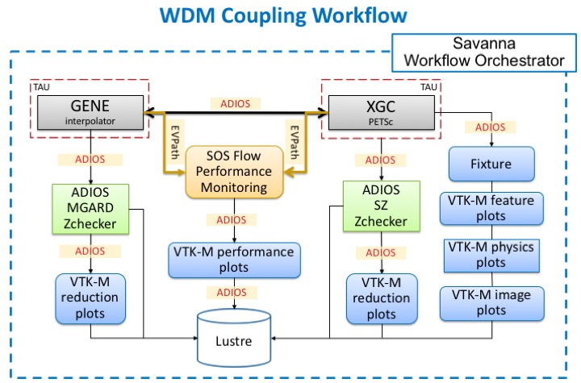
Coupling With In Situ Services: Fusion Example

Slide 12
Workflow Tools for Coupling and Dynamic Workflow Composition
EFFIS
Cheetah-Savanna

Slide 13
EFFIS 1.0 (developed for one-way, weak coupling)
Data Mining
Dashboard
EFFIS 1.0 Services
Adaptable I/O
Workflows
Dashboard
Provenance
Code coupling
WAN data movement
Visualization
Approach: Place highly annotated, fast, easy-to-use I/O methods in the code, which can be monitored and controlled; have a workflow engine record all the information; visualize this on a dashboard; move desired data to the user’s site; and have everything reported to a database.
Benefit: automate complex tasks and allow users to interact through simple interfaces that expose physics products remotely over the web.
Visualization
Wide-area
data
movement
Workflow
Code
coupling
Provenance
and
metadata
Adaptable I/O
Foundation services
Enabling services
Cummings, Julian, Jay Lofstead, Karsten Schwan, Alexander Sim, Arie Shoshani, Ciprian Docan, Manish Parashar, Scott Klasky, Norbert Podhorszki, and Roselyne Barreto. "Effis: an end-to-end framework for fusion integrated simulation." In 2010 18th Euromicro Conference on Parallel, Distributed and Network-based Processing, pp. 428-434. IEEE, 2010.

Slide 14
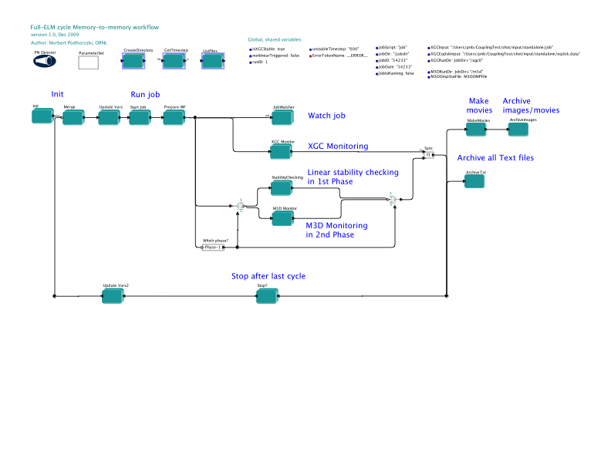
Complications in “traditional” workflow systems
If workflow systems can NOT tap into the data-stream, they become complicated, and difficult to modify and maintain
The DAG becomes a DCG (need to have a cycle, not just a DAG)
Example: We want to implement an expression in Kepler: If stability == 0 then stop workflow
The circle components are complex graphs to implement a control interface into the workflow, which is specific for each type of control
This becomes difficult and almost impossible in most workflow systems for users to implement
This is the main complaint from scientists
The command and control capability in EFFIS 1.0
Klasky, Scott, Matthew Wolf, Mark Ainsworth, Chuck Atkins, Jong Choi, Greg Eisenhauer, Berk Geveci et al. “A view from ORNL: Scientific data research opportunities in the big data age.” In 2018 IEEE 38th International Conference on Distributed Computing Systems (ICDCS), pp. 1357-1368. IEEE, 2018.

Slide 15
What do we need?
We need a capability for the WMS to “tap” into the data stream(s)
Get the knowledge of what “variables” are flowing
Get the “data” and evaluate expression
Need to design a system based on a pub/sub I/O framework
We need a capability to steer a task (user’s executable)
i.e. Data/control from workflow into the task
For the ability to compose a dynamic workflow
Insert pragmas, expression on the “data” which flows through the workflow into the services/codes
We need the capability for the workflow to send data back to the services “Command & Control”

Slide 16
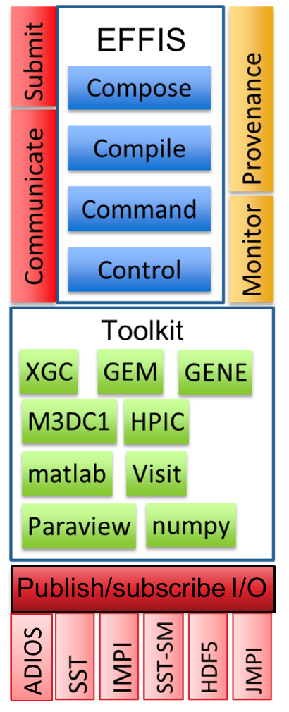
What is EFFIS 2.0?
EFFIS 2.0 is a workflow coordinator to support dynamic workflows
EFFIS 2.0 is a collection of services to
Compose dynamic workflows
Execute the workflows on a “handful” of resources
Command and control the services in the workflow
Allows services to publish and subscribe data through a well-defined interface
EFFIS 2.0 support dynamic workflows on HPC resources (DOE, …) over to edge resources
Allows “easy” integration to visualization tools (Visit, Python, etc.)
https://github.com/wdmapp/effis
SAVANNA

Slide 17
EFFIS 2.0 is built to support “dynamic” workflows
Command and control
Expression
EFFIS Metadata Service
EFFIS Visualization Service
SAVANNA
EFFIS Performance Service
XGC1
GENE
if (max.xgc.analysis.ne) > 1.0 exec (my.analysis2)
Distribution Analysis
EFFIS Provenance Service
EFFIS 2.0 requires a publish/subscribe interface
The EFFIS Metadata Data Service subscribe to all of the data flowing through the system
E.g. Performance Data, Simulation Data
EFFIS 2.0 Provenance Service collects the history of events occurring through the system
Steps, Min/MAX/statistics
Command and Control Service allows scientist to type expression (conditionals, etc.) based on what is flowing through the system
Visualization Service allows simple plots (via. Xena, matplotlib, …) to visualize data as it flows through the system

Slide 18
Composition is specified from high-level config file
Key-value pairs that define the job’s composition
File is scoped, with different sections for:
Machine to run on
Which codes to run and their process decomposition
Custom user definitions that can be used throughout the file
Current supported file type is YAML
Python script parses input file then composes the job to submit
Leverages ECP CODAR’s Savanna
Knows details of schedulers at different computing facilities and enables users to configure complex jobs in a uniform way
jobname: simple
machine:
name: local
share-nodes:
- [writer, reader]
run:
writer:
processes: 1
processes-per-node: 1
.Jabberwocky:
output_path: test-file.bp
adios_engine: BP4
reader:
processes: 1
processes-per-node: 1
.Jabberwocky:
reads: writer.Jabberwocky
monitors:
filename: test-monitor.py
calls:
mon: test_monitor(writer.Jabberwocky.RandomInts)

Slide 19
Cheetah-Savanna Workflow Toolsuite
Cheetah and Savanna from the CODAR project – Codesign Center for Online Data Analysis and Reduction
Cheetah is a campaign management tool
Allows users to setup parametric studies in Python on different supercomputers
Savanna
In situ runtime engine that runs Cheetah experiments and translates Python code into low-level system details
Scheduler Interfaces
Process pinning
Provides an interface to explore fine-grained process placement

Slide 20
Architecture
Workflow composition – Cheetah
Sweep specification
Workflow execution – Savanna
Machine configurations
Scheduler interfaces
Built around ADIOS

Slide 21
Reducing and Analyzing Data - Off-node vs. On-node
Off-node – Simulation and analysis applications run on different nodes, all data needs to be shipped across nodes
On-node – They share compute nodes, data may be analyzed locally

Slide 22
Node-sharing on Summit
Separate Sockets
Shared Sockets

Slide 23
Future Plans for Cheetah and Savanna
Dynamic workflow tuning
Optimizing workflow progress
Explore process placement options
Efficient resource utilization
Leverage work done in the SODA project
Runtime abstractions for online orchestration of data analytics
Monitor runtime behavior
Respond to runtime changes

Slide 24
Thank you
Questions?

